Slide 1
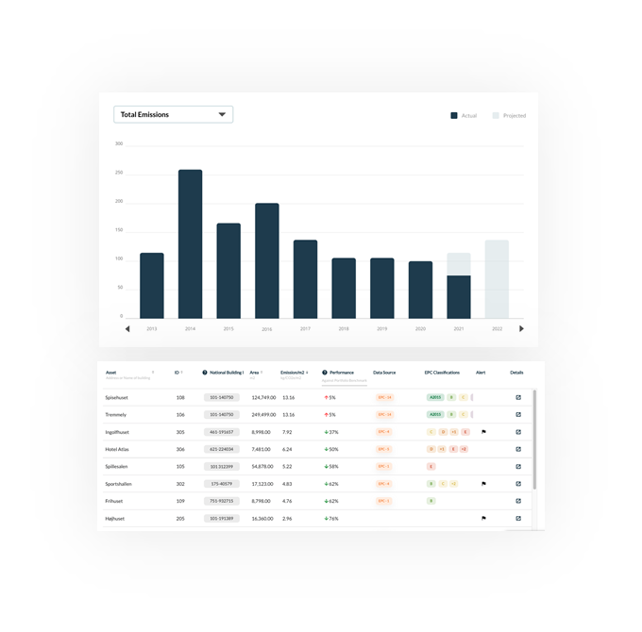
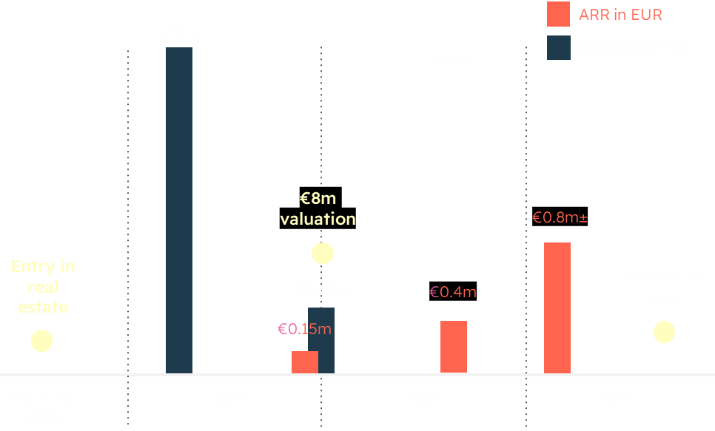
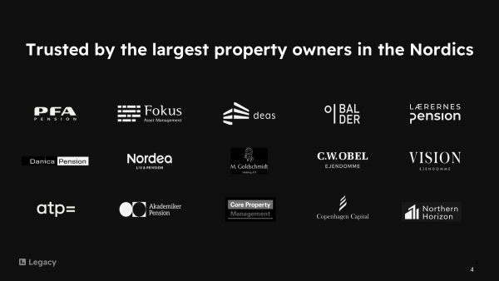
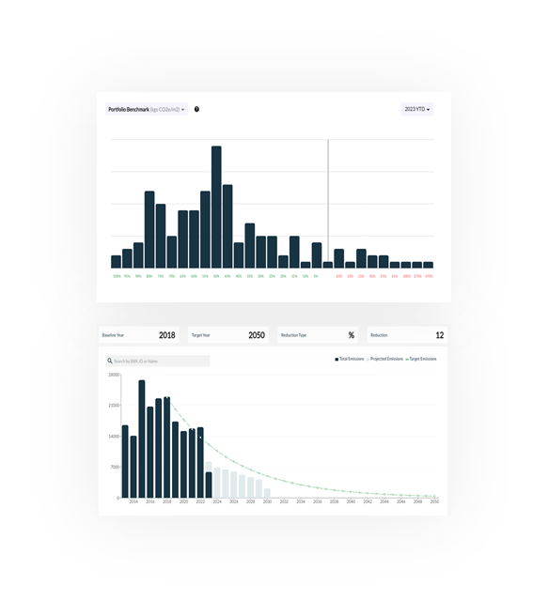
Legacy is an automated carbon accounting and reporting platform for real estate owners
Our purpose is to direct capital towards decarbonisation. We focus on financed emissions – those emissions associated with investments
Legacy provides investment funds, banks, administrators and governments with data-driven insights on a national scale. We enable them to make decisions to enhance the value of their portfolios and comply with regulations
We are trusted by the some of the largest property owners in the Nordics
1. Automated CO2 emissions calculations
We have good traction so far
Automatic ‘meter-level’ API data collection for >90% of buildings in DK and UK
100% CO2 emissions coverage for whole portfolio
Transparent GHG-compliant calculations for each building in portfolio
2. Automated CO2 reporting
1-click standardized reporting
Inventory of utility consumption + emissions data
All data sources, calculations and methodologies audit-ready (ISAE3000)
We are looking to raise €5-8m in H1 2024
This will enable us to continue our journey to becoming the go-to platform for financed emissions data and insights
Our clients trust us because we do three things well
We are led by a diverse leadership team with high quality experience
3. Providing decision making tools and insights
Highest quality CO2 emissions data on 1.5m buildings in DK, and >10m buildings in UK
AI/ML enables benchmarks clients can use for comparison/targets + the 'Legacy Index’ which categorises buildings by attribute and ranks them by emissions, nationally
Contact: Barry Trout
CEO
bjt@wearelegacy.co.uk
+44 7900 504 419
Notes:
Legacy solves the data problem
We are an automated carbon accounting and reporting platform for real estate assets
We provide them with data and insights to enable them to take action to maximise value

