Slide 1
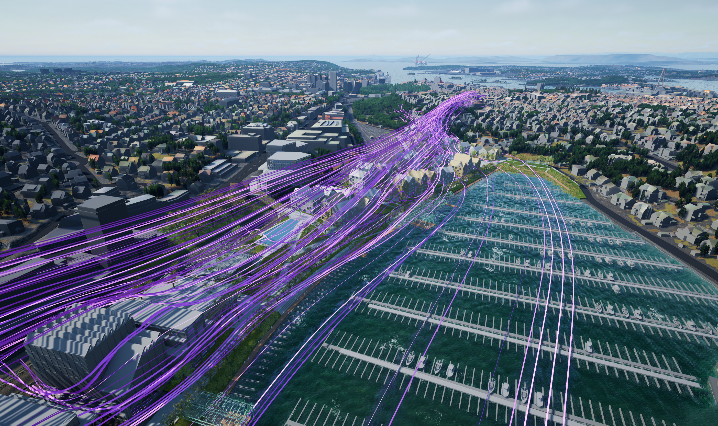
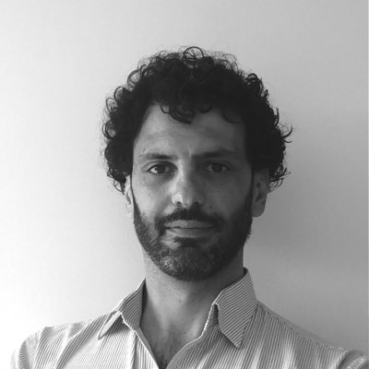
mastering wind
Luca Oggiano, PhD
CEO
+47 456 91711
lo@nablaflow.io

Slide 2
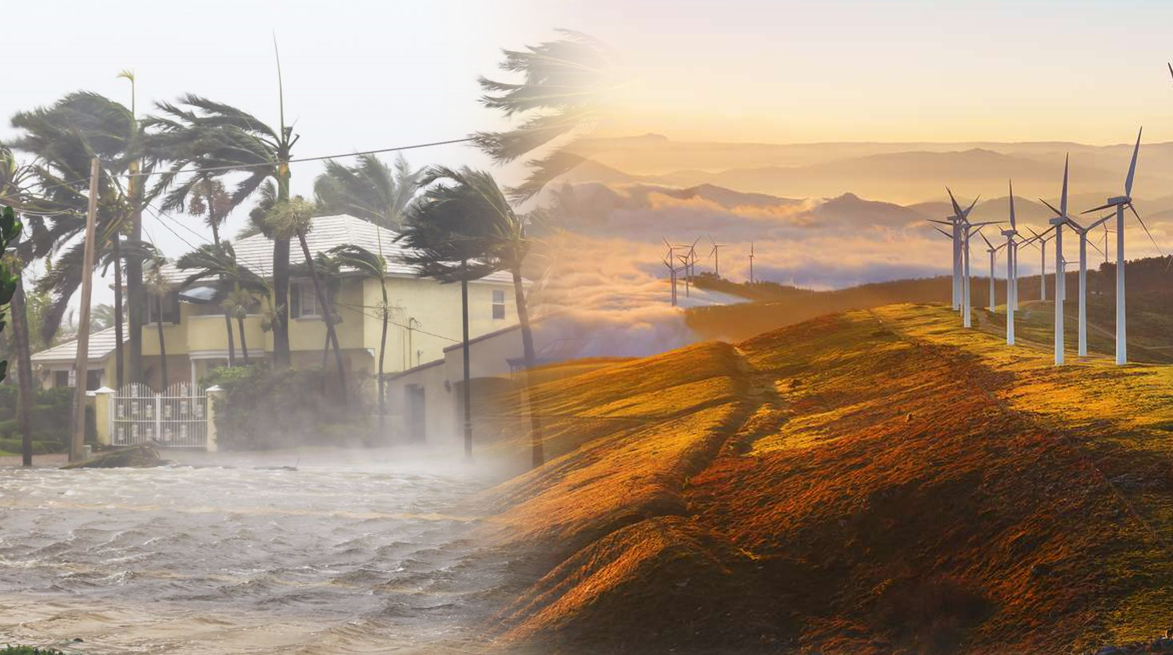
EXTREME WEATHER IS THE NEW NORM
Wind driven
Wildfires
+14% by 2030
+30% by 2050
+50% by 2100
Higher temperatures
Higher Humidity
Higher winds
50TW of wind
capacity
Only 1% used

Slide 3
WIND IS A THREAT AND A RESOURCE
and climate change will force us to adapt
We will have to
protect our cities from hurricanes, predict where wildfires might go,
create safe and comfortable spaces
…
make our cars drive longer,
make our batteries cool better
…
be better at harvesting the wind energy, conveying it in optimal ways
Current solutions
User Experience
Cost
Complexity

Slide 4
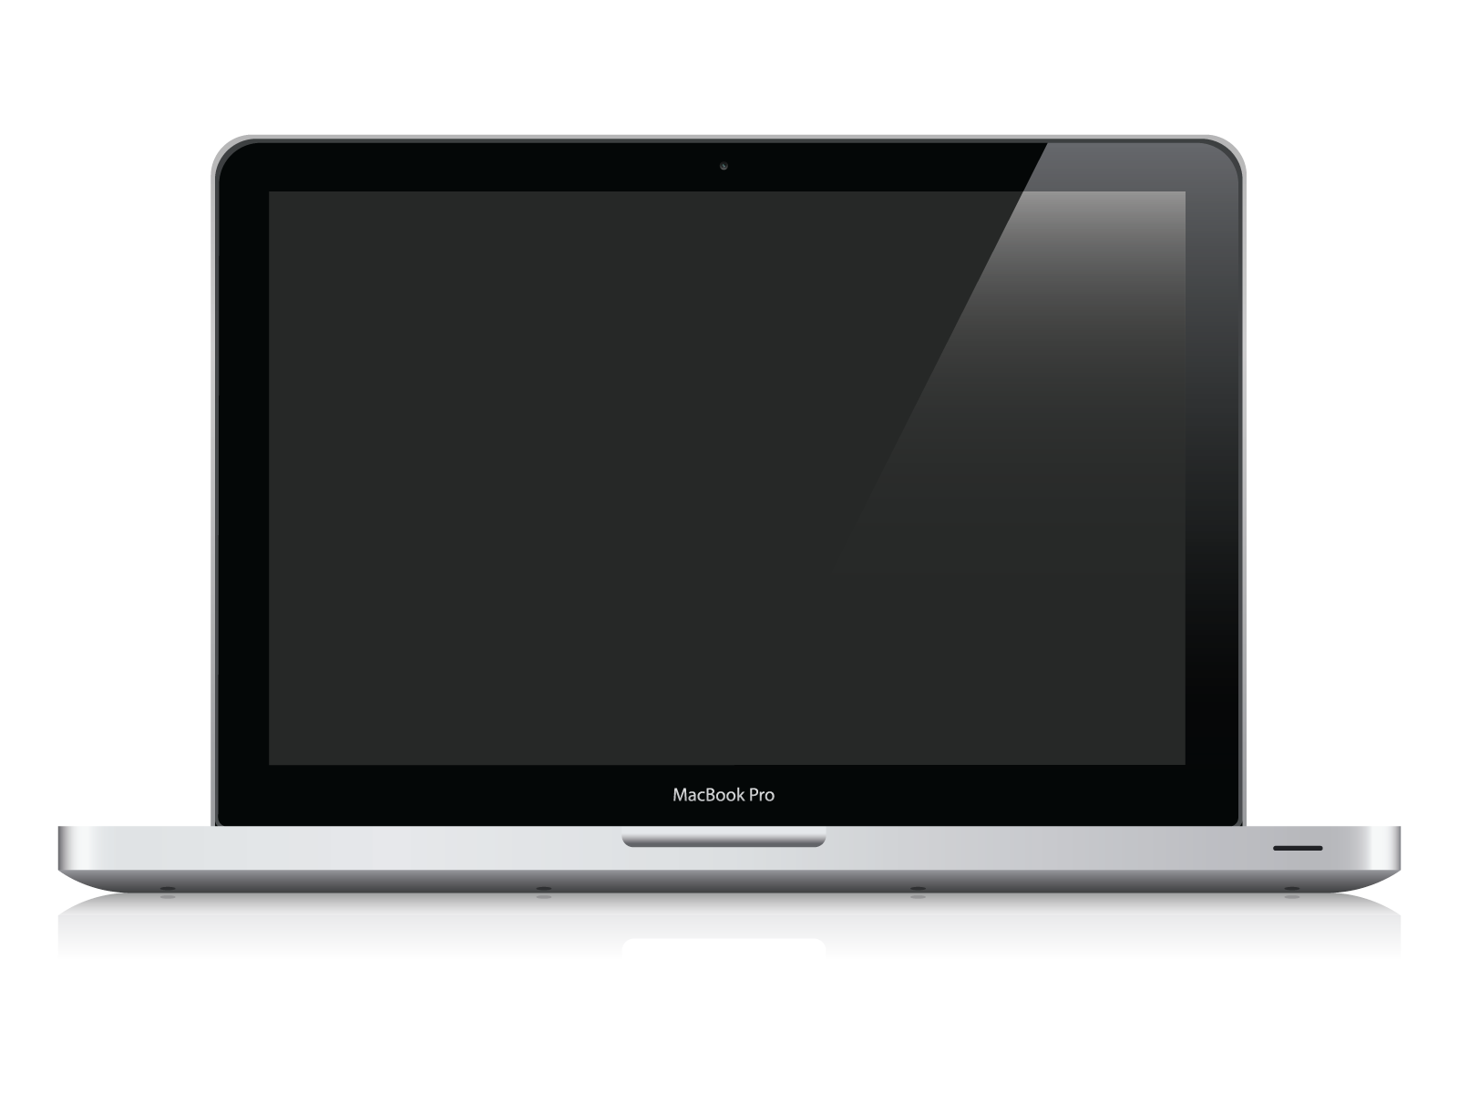
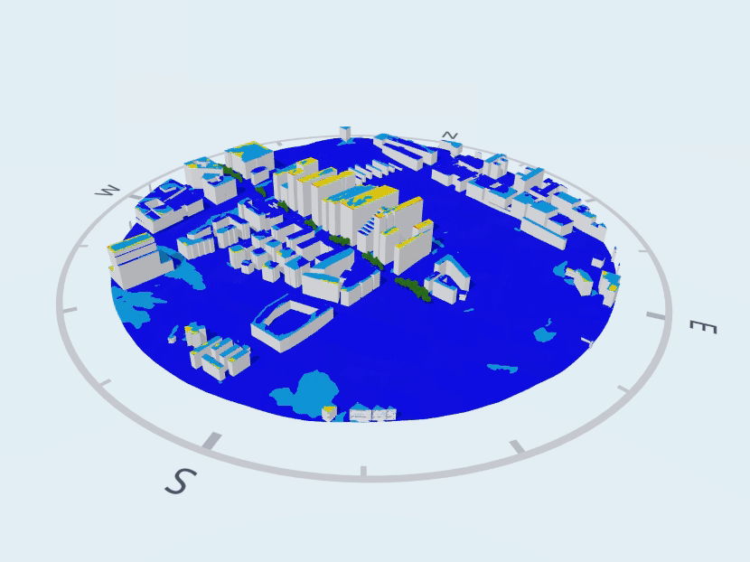
Hyperscaling digital twins simulations with AI and Cloud computing F1 technology to your fingertip through a SaaS platform
THE SOLUTION
Patent
protected

Slide 5
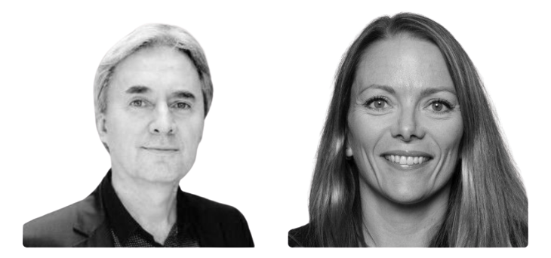
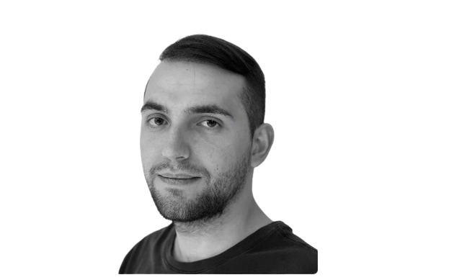
NABLAFLOW IN A NUTSHELL
Multi competent and
highly skilled team

Slide 6
NABLAFLOW IN A NUTSHELL
Recurring
great
customers
0% churn
0.6MEur AR
+50% annual

Slide 7
BOOTSTRAPPED, WITH A STRONG TEAM, LOOKING TO EXPAND AND SCALE
Raising
1.5MEur
to strengthen
our commercial
position
and
go global
Strengthen sales team
Build customer support team
Strengthen the DevTeam
Open offices in strategic locations
Luca Oggiano, PhD
CEO
+47 456 91711
lo@nablaflow.io

