Slide 1
, &

Slide 2
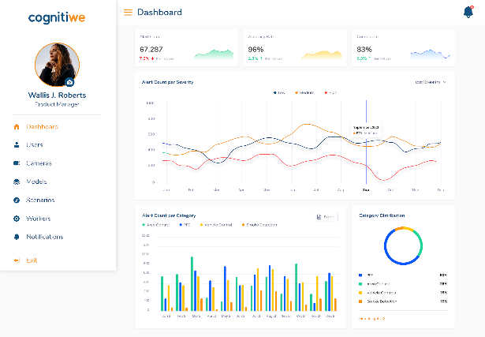
About Cognitiwe
Gain Insight!
Cognitiwe provides retailers and brands with a suite of products designed to analyze product movements, stock levels, and sales performance on their shelves. This enables them to optimize shelf stock, minimize waste, and maximize sales. By offering real-time insights and data-driven forecasts, Cognitiwe empowers its customers to enhance operational efficiency and bolster their sustainability efforts, ultimately leading to increased profitability.

Slide 3
Problem Faced by Retail
Lack of Insight & Optimisation
In the retail sector, lacking accurate data and actionable insights for effectively managing shelf stocks can lead to substantial losses.

Slide 4
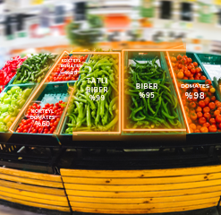
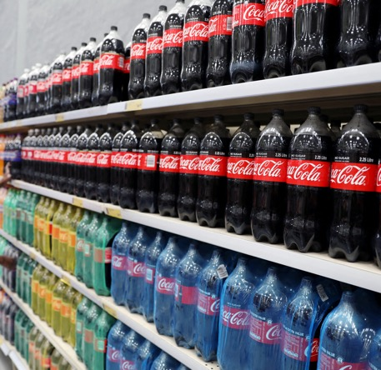
Problem in Numbers
Lack of Insight & Optimisation
Waste of Food
Loss of Sales
Loss of Inventory
Average annual supermarket waste is 11.4% for fresh fruit and 9.7% for vegetables.
Retailers globally lose €1.2 trillion in sales annually due to out-of-stock items on shelves.
Shoplifting accounts for $62 billion in annual losses for US retailers, 36% of all shrinkage.

Slide 5
Cognitiwe Retail Suite
Insight & Optimization through AI
tomato
95%
pepper 97%
pepper 75%
tomato
85%
tomato
35%
Shelf & Planogram
Fresh Food Monitoring
Fraud & Shrinkage
weshelf streamlines packaged goods management by tracking inventory on shelves and in boxes, offering valuable insights into stock levels and planogram compliance.
wefresh revolutionizes fresh produce and food inventory management for retailers. By providing real-time insights into products on shelves, it transforms traditional inventory management practices.
wewatch safeguards the checkout process by automatically monitoring shopping carts in designated areas. This ensures that carts are empty before leaving, preventing potential fraud and shrinkage.

Slide 6
Impact
Improved sales, reduced costs

Slide 7
Unique Advantages
Easy & Low Cost
Onboarding
Real Time &
Predictive Data Analysis
No special hardware required
Self Onboarding
Analyzes the past data to predict the future
%99.8 accuracy in fullness rate in real-time
Compliant to GDPR
Sustainability
Prioritizes the privacy of our users and their customers
Inline with UN’s Goal 8 & 12
Prevents food waste, use resources efficiently

Slide 8
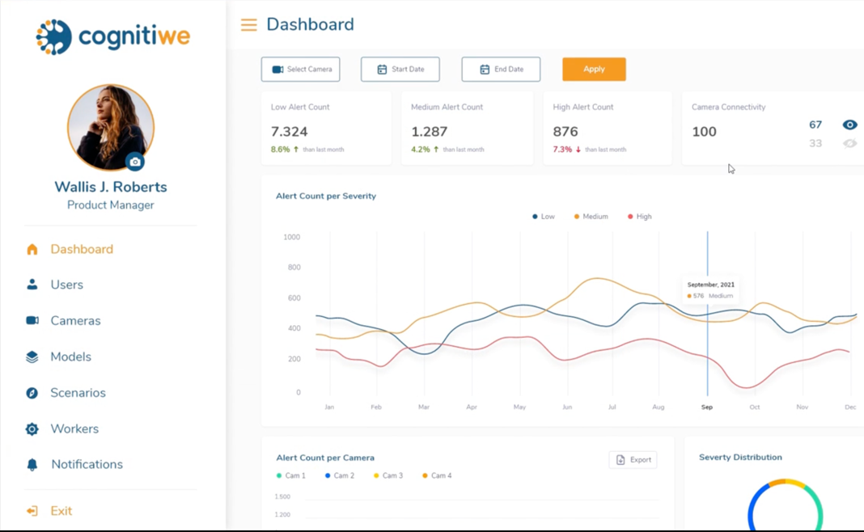
Easy to Use
No Code Self-Service
Sign Up
Connect the camera
Select
the model

Slide 9
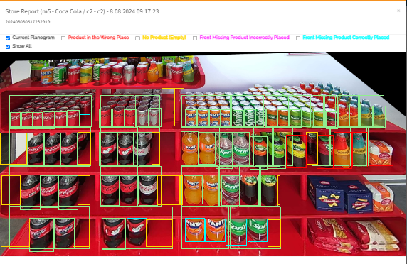
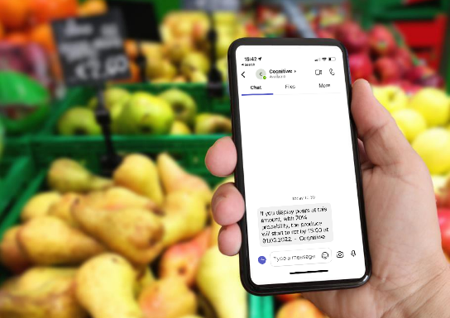
Unlocking Insights
Get the Data You Need
Customer Dashboard
Visual Reports
Email and Instant Messages
(*) On-demand ERP integration available.

Slide 10
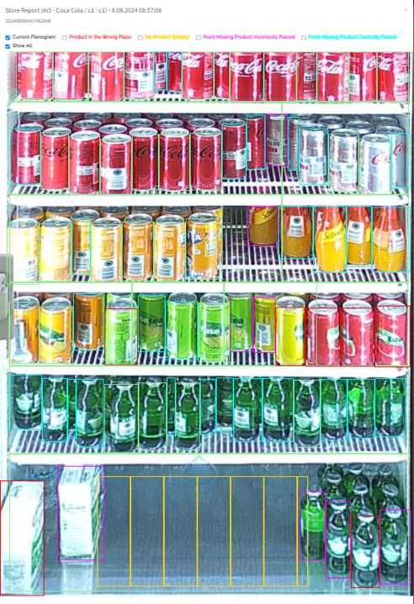
KPIs that can be Extracted
Get the Data You Need
-Planogram Compliance
-Product Placement Accuracy
-Empty Space Detection
-Missing Products in Facing
-Facing: Expected vs. Live
-Critical Stock Products & Rate
-Out-of-Stock Products & Rate
-Replenishment Time
-Supplier Share
-Brand Share
-Shelf Availability Rate
And daily trends analysis of these KPIs.

Slide 11
Competitor Landscape
Cognitiwe has a more comprehensive product with better effective analytics
 | Cognitiwe | Afresh | Captana | Clarifruit | Trax
Target Market | Fresh Food in Supermarkets, Cafes, Bakeries, etc. | Fresh Food in Supermarkets | Consumer Goods in Supermarkets | Fresh Food in Production | Consumer Goods in Supermarkets
Country | Estonia | USA | Germany | Israel | USA
Fresh Food Monitoring | YES | YES | NO | NO | NO
Freshness Monitoring | YES | NO | NO | YES | NO
Consumer Goods Monitoring | YES | NO | YES | NO | YES
Real Time Analytics | YES | NO | YES | YES | YES
Predictive Analytics | YES | YES | NO | NO | NO
Comprehensiveness
Analytics

Slide 12
Business Model
Metered Subscription
No upfront investments.
No onboarding fees unless the customer requests specific customizations such as branding or ERP integration.
Self-service.
Monthly
SaaS model
€125
Per camera
OR
€1.200
Per store or location

Slide 13
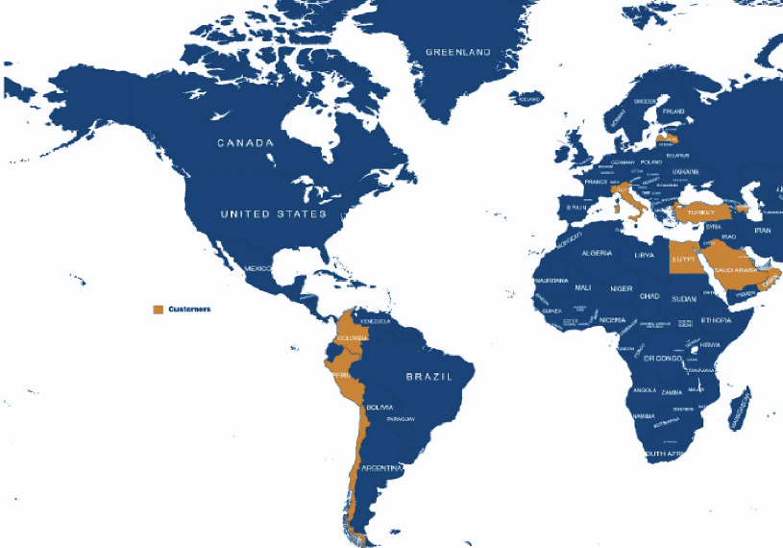
Cognitiwe’s GTM
15 countries & 4 continents

Slide 14
Current Metrics
KPIs
Active Funnel
1st Stage
2nd Stage
Final Stage
€45K
MRR
€70K
Total Cost
€350K
€450K
€2.4M
Customer Discussions
Negotiations
Deals in Closing
PoC’s
Pipeline
Customers
TURKEY
DUBAI
SWISS
CYPRUS
7
Paying
Customers
23
Customers
in trial
15
Active
in countries

Slide 15
Founding Team
Founders with complementary skill-sets & long-term business partners over 20 years
Mete Bayrak
Co-founder & CINO
Attila Algan
Co-founder & CEO
Area of Expertise
IT, Technical Development, Image Recognition, Innovation
Area of Expertise
Product Management, Marketing,
Digital Services, Sales, Go to Market
Education
Istanbul University
Electronic Engineering
Education
Istanbul University
Electronic Engineering
Past Experience
More than 20 years of technical &
business development experience
2 times entrepreneur + 1 exit (Ininal exited to Multinet)
Past Experience
More than 20 years in marketing management, go to market strategies and leadership roles held in Nokia, Samsung, Avea
Notes:
Mete bey diğer startuplar - board member & investor

Slide 16
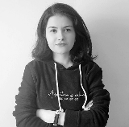
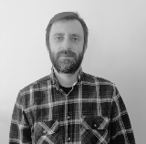
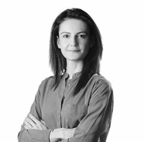
WE Team
Engineers
3 Visual AI Engineers
2 Machine Learning Engineers
Damla Fikirdanış
Ozan Bayar
Selcan Atak
Mehmet Genç
Taha Altınışık
AI Engineer
Software Engineer
AI Engineer
Computer
Vision Engineer
Software Engineer
3 Software Engineers
...
2 Electronic Engineers
Yusuf Dede
Senem Aktaş
Serkan Güre
Yalçın Köseoğlu
Fahri Çetin
Software Engineer
ML Engineer
CAIO
CTO
Technical Operations Manager
2 System Engineers
Product & Marketing
Selin Filiz
Ceylan Azeboğlu
40% female Median age 33
Head of Marketing
CPO

Slide 17
Addressable Market Size
TOTAL RETAIL MARKET
The global AI in retail market size is expected to expand by 23.9% from 2022 to 2030.
Only in Europe, there are more than 1.000 groceries with more than 100.000 stores.
Image recognition market size for groceries only is about $15B.
$119B
AI
SERVICEABLE MARKET
$40B
AI Groceries
TAM
$15B*
Visual AI
Groceries
* 100K stores in Europe, 1M stores in the world, average $1.500 per store

Slide 18
Keep in touch!
+905336293601
attila.algan@cognitiwe.com

